Slide 1


- Data Science Capstone Project
Seongjoo (Brenden) Song November 4, 2021

Slide 2
Outline
Executive Summary
Introduction
Methodology
Results
Conclusion
Appendix

Slide 3
Executive Summary
Summary of methodologies
Data collection
Data wrangling
EDA with data visualization
EDA with SQL
Building an interactive map with Folium
Building a Dashboard with Plotly Dash
Predictive analysis (Classification)
Summary of all results
Exploratory data analysis results
Interactive analytics demo in screenshots
Predictive analysis results

Slide 4
Introduction
Project background and context
The era of commercial space has arrived, and there are several companies that are making space travel affordable for everyone. Perhaps the most successful of them is SpaceX, and one of the reasons is that their rocket launch is relatively inexpensive.
SpaceX advertises Falcon 9 rocket launches on its website, with a cost of 62 million dollars; other providers cost upward of 165 million dollars each, much of the savings is because SpaceX can reuse the first stage.
Therefore, we will predict if the Falcon 9 first stage will land successfully. If we can determine if the first stage will land, we can determine the cost of a launch. This information can be used if an alternate company wants to bid against SpaceX for a rocket launch.
Problems you want to find answers
Correlations between each rocket variables and successful landing rate
Conditions to get the best results and ensure the best successful landing rate
4

Slide 5

5

Slide 6
Methodology
Executive Summary
Data collection methodology:
SpaceX API & Web Scraping Falcon 9 and Falcon Heavy Launches Records from Wikipedia
Perform data wrangling
Convert outcomes into Training Labels with the booster successfully/unsuccessful landed
Perform exploratory data analysis (EDA) using visualization and SQL
Perform interactive visual analytics using Folium and Plotly Dash
Perform predictive analysis using classification models
Find best Hyperparameter for SVM, Classification Trees and Logistic Regression
6

Slide 7


Data Collection
The data collection process includes a combination of API requests from the SpaceX API and web scraping data from a table in the Wikipedia page of SpaceX, Falcon 9 and Falcon Heavy Launches Records.
SpaceX API Data Columns: FlightNumber, Date, BoosterVersion, PayloadMass, Orbit, LaunchSite, Outcome, Flights, GridFins, Reused, Legs, LandingPad, Block, ReusedCount, Serial, Longitude, Latitude
Wikipedia Web Scrape Data Columns: Flight No., Launch site, Payload, PayloadMass, Orbit, Customer, Launch outcome, Version Booster, Booster landing, Date, Time
SpaceX API Web Scraping
Request data from SpaceX API
API
returns SpaceX data
in
.JSON file
Get HTML
Response from Wikipedia page
Extract data using beautiful soup
Normalize data into
CSV file
Normalize data into
CSV file
7

Slide 8
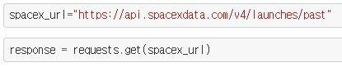
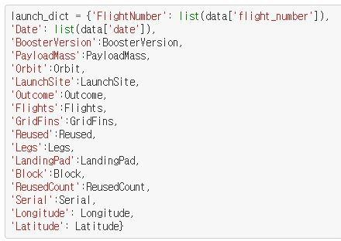
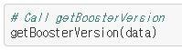
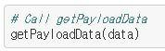
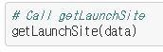
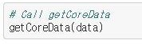
Data Collection – SpaceX API
1.Requesting rocket launch data from SpaceX API
4.Combining the columns into a dictionary to create data frame
2.Converting Response to a JSON file
3.Using custom functions to clean data
5.Filtering dataframe and exporting to a CSV
• GitHub URL

Slide 9
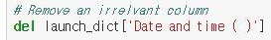
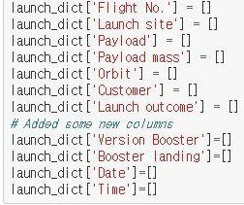
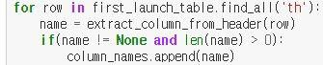
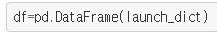
Data Collection – Scraping
Getting response from HTML
Creating a BeautifulSoup object
Finding all tables and assigning the result to a list 4.Extracting column name one by one
5.Creating an empty dictionary with keys
Filling up the launch_dict with launch records
(Too long to put in here, so please refer to the notebook)
Creating a Dataframe and exporting it to a CSV
• GitHub URL

Slide 10
Data Wrangling
There are several cases in which the booster failed to successfully land on the dataset, and sometimes it attempted to land but failed because of accident.
True Ocean: the mission result has successfully landed in a specific area of the ocean
False Ocean: the mission result has not successfully landed in a specific area of the ocean
True RTLS: the mission result successfully landed on the ground pad
False RTLS: the mission result has not successfully landed on the ground pad
True ASDS: the mission result has successfully landed on the drone ship
False ASDS: the mission result has not landed on the drone ship
Converting these results into training labels:
1 = successful / 0 = failure
• GitHub URL

Slide 11
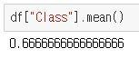
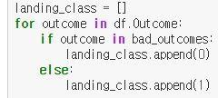
Data Wrangling
Calculating the number of launches at each site
Calculating the number and occurrence of each orbit
Calculating the number and occurrence of mission outcome per orbit type
Creating a landing outcome label from Outcome column
5.Calculating the success rate for every landing in dataset
6.Exporting dataset to a CSV
• GitHub URL

Slide 12
EDA with Data Visualization
Scatter chart:
Flight Number vs. Launch Site
Payload vs. Launch Site
Flight Number vs. Orbit Type
Payload vs. Orbit Type
A scatter plot shows how much one variable is affected by another. The relationship between two variables is called a correlation. This plot is generally composed of large data bodies.
Bar chart:
Orbit Type vs. Success Rate
A Bar chart makes it easy to compare datasets between multiple groups at a glance. One axis represents a category and the other axis represents a discrete value. The purpose of this chart is to indicate the relationship between the two axes.
Line chart:
Year vs. Success Rate
A Line chart shows data variables and trends very clearly and helps predict the results of data that has not yet been recorded.
• GitHub URL

Slide 13
EDA with SQL
Loading the dataset into the corresponding table in a Db2 database, and executing SQL queries to answer following questions:
Displaying the names of the unique launch sites in the space mission
Displaying 5 records where launch sites begin with the string 'CCA'
Displaying the total payload mass carried by boosters launched by NASA (CRS)
Displaying average payload mass carried by booster version F9 v1.1
Listing the date when the first successful landing outcome in ground pad was achieved
Listing the names of the boosters which have success in drone ship and have payload mass greater than 4000 but less than 6000
Listing the total number of successful and failure mission outcomes
Listing the names of the booster_versions which have carried the maximum payload mass
Listing the failed landing_outcomes in drone ship, their booster versions, and launch site names for in year 2015
Ranking the count of landing outcomes (such as Failure (drone ship) or Success (ground pad)) between the date 2010-06-04 and 2017-03-20, in descending order
• GitHub URL

Slide 14
Build an Interactive Map with Folium
Objects created and added to a folium map:
Markers that show all launch sites on a map
Markers that show the success/failed launches for each site on the map
Lines that show the distances between a launch site to its proximities
By adding these objects, following geographical patterns about launch sites are found:
Are launch sites in close proximity to railways? Yes
Are launch sites in close proximity to highways? Yes
Are launch sites in close proximity to coastline? Yes
Do launch sites keep certain distance away from cities? Yes
• GitHub URL / IBM Cloud URL (for interactive maps)

Slide 15
Build a Dashboard with Plotly Dash
The dashboard application contains a pie chart and a scatter point chart.
Pie chart
For showing total success launches by sites
This chart can be selected to indicate a successful landing distribution across all launch sites or to indicate the success rate of individual launch sites.
Scatter chart
For showing the relationship between Outcomes and Payload mass (Kg) by different boosters
Has 2 inputs: All sites/individual site & Payload mass on a slider between 0 and 10000 kg
This chart helps determine how success depends on the launch point, payload mass, and booster version categories.
• GitHub URL (code only)

Slide 16



Predictive Analysis (Classification)
Perform exploratory Data Analysis and determine Training Labels
Create a column for the class
Standardize the data
Split into training data and test data
BUILDING MODEL
EVALUATING MODEL
Find best Hyperparameter for SVM, Classification Trees and Logistic Regression
Find the method performs best using test data
FINDING THE BEST
PERFORMING CLASSIFICATION MODEL
IMPROVING MODEL
• GitHub URL

Slide 17
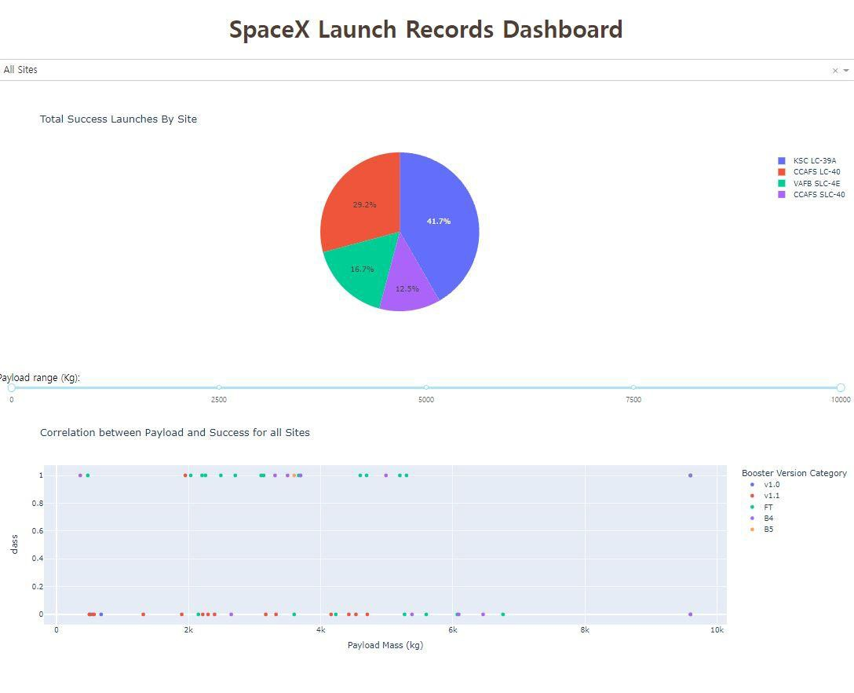
Results
The left screenshot is a preview of the Dashboard with Plotly Dash.
The results of EDA with visualization, EDA with SQL, Interactive Map with Folium, and Interactive Dashboard will be shown in the next slides.
Comparing the accuracy of the four methods, all return the same accuracy of about 83% for test data.
17

Slide 18


Slide 19
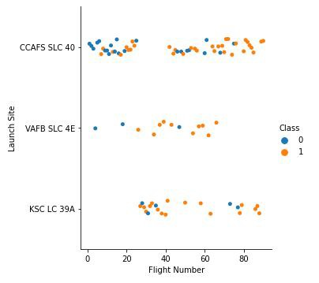
Flight Number vs. Launch Site
Class 0 (blue) represents unsuccessful launch, and Class 1 (orange) represents successful launch.
This figure shows that the success rate increased as the number of flights increased.
As the success rate has increased considerably since the 20th flight, this point seems to be a big breakthrough.

Slide 20
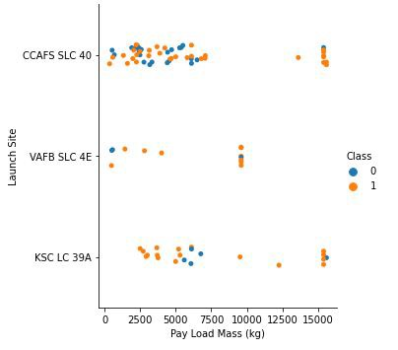
Payload vs. Launch Site
Class 0 (blue) represents unsuccessful launch, and Class 1 (orange) represents successful launch.
At first glance, the larger pay load mass, the higher the rocket's success rate, but it seems difficult to make decisions based on this figure because no clear pattern can be found between successful launch and Pay Load Mass.

Slide 21
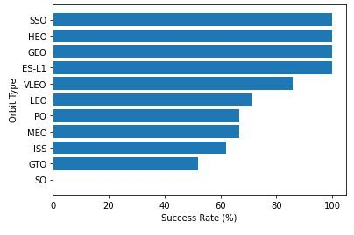
Success Rate vs. Orbit Type
Orbit types SSO, HEO, GEO, and ES-L1 have the highest success rates (100%).
On the other hand, the success rate of orbit type GTO is only 50%, and it is the lowest except for type SO, which recorded failure in a single attempt.

Slide 22
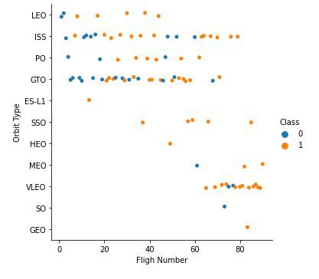
Flight Number vs. Orbit Type
Class 0 (blue) represents unsuccessful launch, and Class 1 (orange) represents successful launch.
In most cases, the launch outcome seems to be correlated with the flight number.
On the other hand, in GTO orbit, there seems to be no relationship between flight numbers and success rate.
SpaceX starts with LEO with a moderate success rate, and it seems that VLEO, which has a high success rate, is used the most in recent launches.

Slide 23
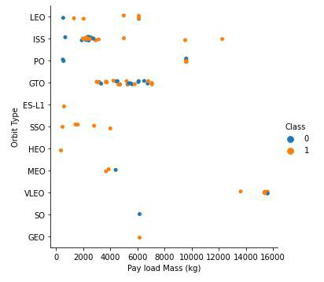
Payload vs. Orbit Type
Class 0 (blue) represents unsuccessful launch, and Class 1 (orange) represents successful launch.
With heavy payloads the successful landing or positive landing rate are more for LEO and ISS.
However, in the case of GTO, it is hard to distinguish between the positive landing rate and the negative landing because they are all gathered together.

Slide 24
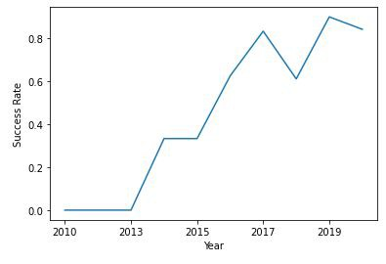
Launch Success Yearly Trend
Since 2013, the success rate has continued to increase until 2017.
The rate decreased slightly in 2018.
Recently, it has shown a success rate of about 80%.

Slide 25

EDA with SQL
Section 3

Slide 26
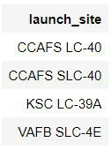
All Launch Site Names
Query
When the SQL DISTINCT clause is used in the query, only unique values are displayed in the Launch_Site column from the SpaceX table.
There are four unique launch sites: CCAFS LC-40, CCAFS SLC-40, KSC LC-39A, VAFB SLC-4E
SELECT DISTINCT LAUNCH_SITE FROM SPACEXTBL
Result

Slide 27
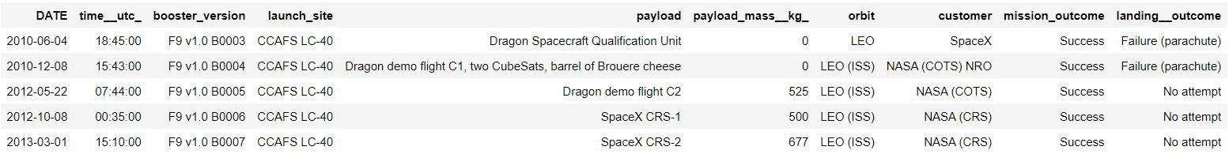
Launch Site Names Begin with 'CCA'
Query
Only five records of the SpaceX table were displayed using LIMIT 5 clause in the query.
Using the LIKE operator and the percent sign (%) together, the Launch_Site name starting with CAA could be called.
SELECT * FROM SPACEXTBL
WHERE LAUNCH_SITE LIKE 'CCA%' LIMIT 5
Result

Slide 28
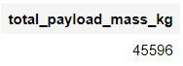
Total Payload Mass
Query
Using the SUM() function to calculate the sum of column PAYLOAD_MASS KG_.
In the WHERE clause, filter the dataset to perform calculations only if Customer is NASA (CRS).
SELECT SUM(PAYLOAD_MASS KG_)
AS total_payload_mass_kg FROM SPACEXTBL
WHERE CUSTOMER = 'NASA (CRS)'
Result

Slide 29
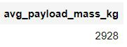
Average Payload Mass by F9 v1.1
Query
Using the AVG() function to calculate the average value of column PAYLOAD_MASS KG_.
In the WHERE clause, filter the dataset to perform calculations only if Booster_version is F9 v1.1.
SELECT AVG(PAYLOAD_MASS KG_)
AS avg_payload_mass_kg FROM SPACEXTBL
WHERE BOOSTER_VERSION = 'F9 v1.1'
Result

Slide 30
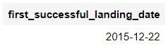
First Successful Ground Landing Date
Query
Using the MIN() function to find out the earliest date in the column DATE.
In the WHERE clause, filter the dataset to perform a search only if Landing outcome is Success (ground pad).
SELECT MIN(DATE)
AS first_successful_landing_date FROM SPACEXTBL
WHERE LANDING OUTCOME
= 'Success (ground pad)'
Result

Slide 31
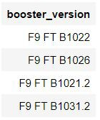
Successful Drone Ship Landing with Payload between 4000 and 6000
Query
SELECT BOOSTER_VERSION FROM SPACEXTBL
WHERE LANDING OUTCOME = 'Success (drone ship)' AND (PAYLOAD_MASS KG_ BETWEEN 4000 AND 6000)
Result
In the WHERE clause, filter the dataset to perform a search if Landing outcome is Success (drone ship).
Using the AND operator to display a record if additional condition PAYLOAD_MASS KG_ is between 4000 and 6000.
31

Slide 32
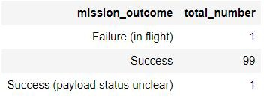
Total Number of Successful and Failure Mission Outcomes
Query
Using the COUNT() function to calculate the total number of columns.
Using the GROUP BY statement, groups rows that have the same values into summary rows to find the total number in each Mission_outcome.
According to the result, SpaceX seems to have successfully completed nearly 99% of its missions.
32
SELECT MISSION_OUTCOME,
COUNT(*) AS total_number FROM SPACEXTBL
GROUP BY MISSION_OUTCOME
Result

Slide 33
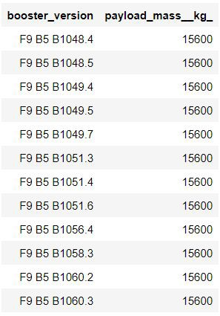
Boosters Carried Maximum Payload
Query • Result
SELECT DISTINCT BOOSTER_VERSION, PAYLOAD_MASS KG_
FROM SPACEXTBL
WHERE PAYLOAD_MASS KG_ = (
SELECT MAX(PAYLOAD_MASS KG_) FROM SPACEXTBL)
Using a subquery, first, find the maximum value of the payload by using MAX() function, and second, filter the dataset to perform a search if PAYLOAD_MASS KG_ is the maximum value of the payload.
According to the result, version F9 B5 B10xx.x
boosters could carried the maximum payload.
33

Slide 34
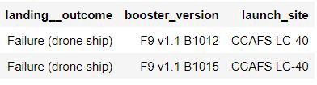
2015 Launch Records
Query
Result
SELECT LANDING OUTCOME, BOOSTER_VERSION, LAUNCH_SITE
FROM SPACEXTBL
WHERE LANDING OUTCOME
= 'Failure (drone ship)' AND YEAR(DATE) = '2015'
In the WHERE clause, filter the dataset to perform a search if Landing outcome is
Failure (drone ship).
Using the AND operator to display a record if additional condition YEAR is
2015.
In 2015, there were two landing failures on drone ships.
34

Slide 35
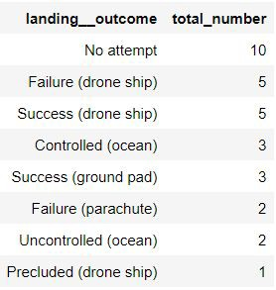
Rank Landing Outcomes Between 2010-06-04 and 2017-03-20
Query • Result
SELECT LANDING OUTCOME,
COUNT(LANDING OUTCOME) AS total_number FROM SPACEXTBL
WHERE DATE BETWEEN '2010-06-04' AND '2017-03-20' GROUP BY LANDING OUTCOME
ORDER BY total_number DESC
In the WHERE clause, filter the dataset to perform a search if the date is between 2010-06-04 and 2017-03-20.
Using the ORDER BY keyword to sort the records by total number of landing, and using DESC keyword to sort the records in descending order.
According to the results, the number of successes and failures between 2010-06-04 and 2017-03-20 was similar.
35

Slide 36


Slide 37


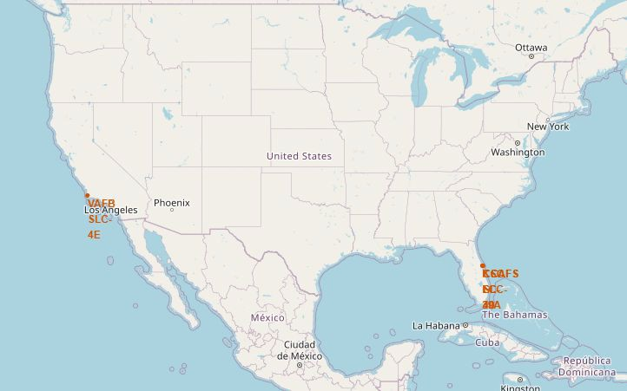
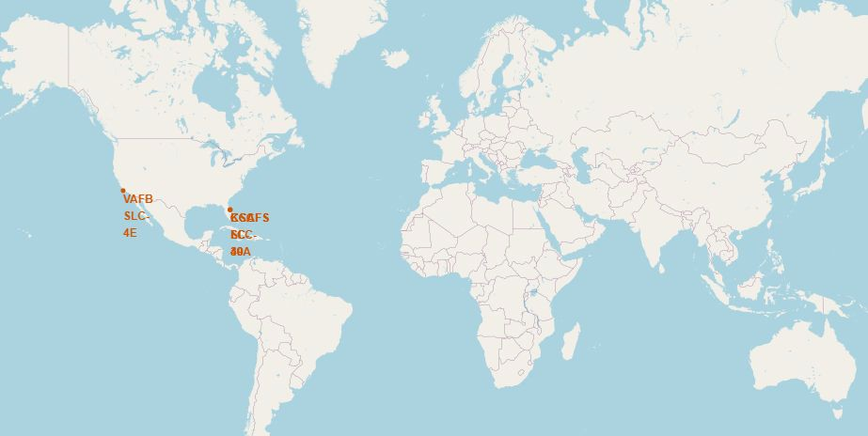
All Launch Sites’ Locations
The left map shows all SpaceX launch sites, and the right map also shows that all launch sites are in the United States.
As can be seen on the map, all launch sites are near the coast.
37

Slide 38


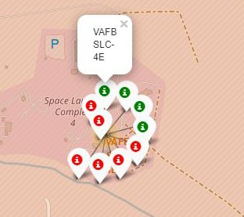
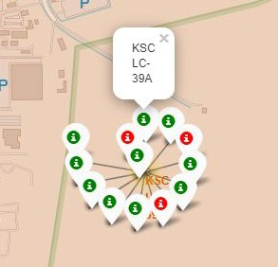
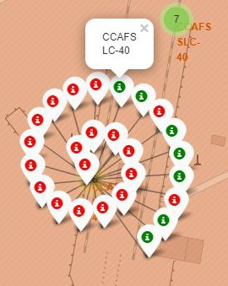
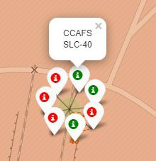
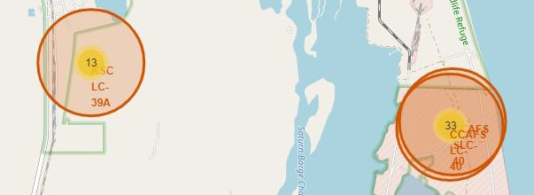
Color-labeled Launch Outcomes
Launch site in California
Launch sites in Florida
By clicking on the marker clusters,
successful landing (green) or failed landing (red) are displayed.
38

Slide 39




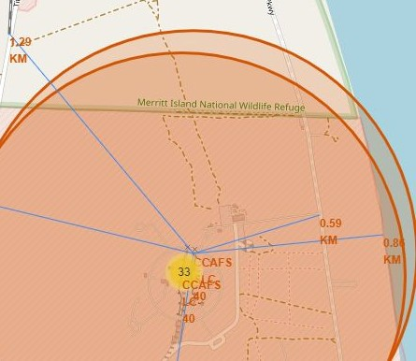
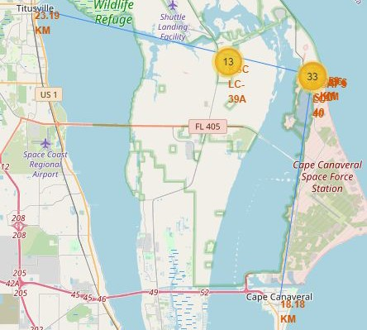
Proximities of Launch Sites
Are launch sites in close proximity to railways? Yes Are launch sites in close proximity to highways? Yes Are launch sites in close proximity to coastline? Yes
Do launch sites keep certain distance away from cities? Yes
It can be found that the launch site is close to railways and highways for transportation of equipment or personnel, and is also close to coastline and relatively far from the cities so that launch failure does not pose a threat.
39

Slide 40


Slide 41
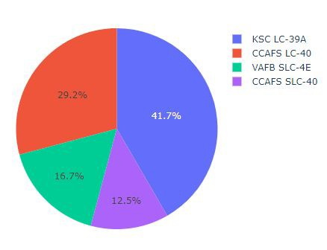
Total Success Launches By all sites
KSLC-39A records the most launch success among all sites.
The VAFB SLC-4E has the fewest launch success, possibly because
the data sample is small, or
because it is the only site located in California, so the launch difficulty on the west coast may be higher than on the east coast.

Slide 42
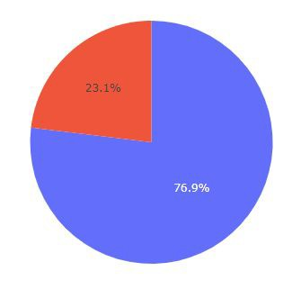

Launch Site with Highest Launch Success Ratio
Total Success Launched for site KSC LC-39A
Success Failure
KSLC-39A has the highest success rate with 10 landing successes (76.9%) and 3
landing failures (23.1%).

Slide 43


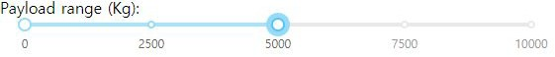
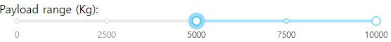


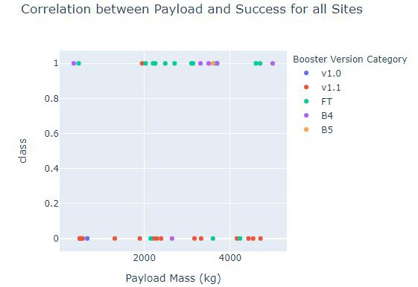
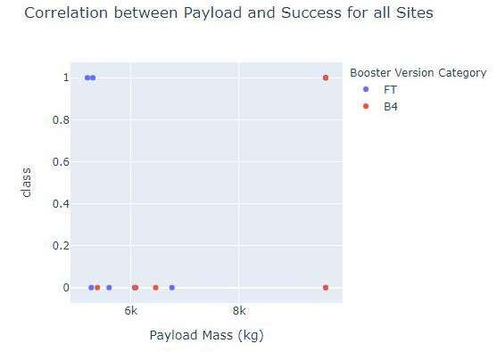
Payload vs. Launch Outcome Scatter Plot for all sites
These figures show that the launch success rate (class 1) for low weighted payloads(0-5000 kg) is higher than that of heavy weighted payloads(5000-10000 kg).
43

Slide 44


Slide 45
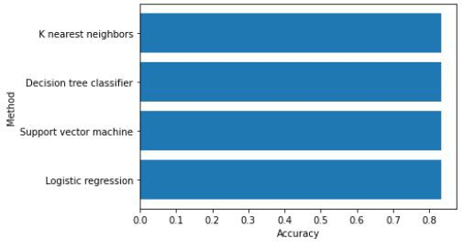
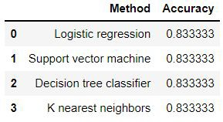
Classification Accuracy
In the test set, the accuracy of all models was virtually the same at 83.33%.
It should be noted that the test size was small at 18.
Therefore, more data is needed to determine the optimal model.

Slide 46
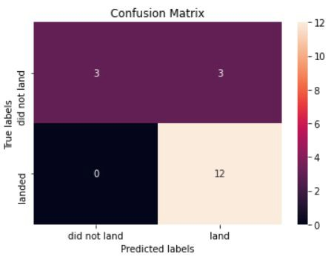
Confusion Matrix
The confusion matrix is the same for all models because all models performed the same for the test set.
The models predicted 12 successful landings when the true label was successful and 3 failed landings when the true label was failure. But there were also 3 predictions that said successful landings when the true label was failure (false positive).
Overall, these models predict successful landings.

Slide 47
Conclusions
As the number of flights increased, the success rate increased, and recently it has exceeded 80%.
Orbital types SSO, HEO, GEO, and ES-L1 have the highest success rate (100%).
The launch site is close to railways, highways, and coastline, but far from cities.
KSLC-39A has the highest number of launch successes and the highest success rate among all sites.
The launch success rate of low weighted payloads is higher than that of heavy weighted payloads.
In this dataset, all models have the same accuracy (83.33%), but it seems that more data is needed to determine the optimal model due to the small data size.

Slide 48
Appendix
https://github.com/kvs788/IBM_DATASCIENCE

Slide 49




r
Ԅ
.r
,,,.....

